Slide 1

Smart garbage monitoring system
Component Testing
Submitted by
Parth Patel (C0754250)

Slide 2
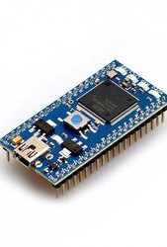
LPC1768
The mbed NXP LPC1768 is one of a range of mbed Microcontrollers packaged as a small 40-pin DIP, 0.1-inch pitch form-factor making it convenient for prototyping with solderless breadboard, stripboard, and through-hole PCBs. It includes a built-in USB programming interface that is as simple as using a USB Flash Drive. Plug it in, drop on an ARM program binary, and its up and running.
NXP LPC1768 MCU
High performance ARM Cortex™-M3 Core
96MHz, 32KB RAM, 512KB FLASH
Ethernet, USB Host/Device, 2xSPI, 2xI2C, 3xUART,
CAN, 6xPWM, 6xADC, GPIO
Prototyping form-factor
40-pin 0.1" pitch DIP package, 54x26mm
5V USB or 4.5-9V supply
Built-in USB drag 'n' drop FLASH programmer
mbed.org Developer Website
Lightweight Online Compiler
High level C/C++ SDK
Cookbook of published libraries and projects

Slide 3

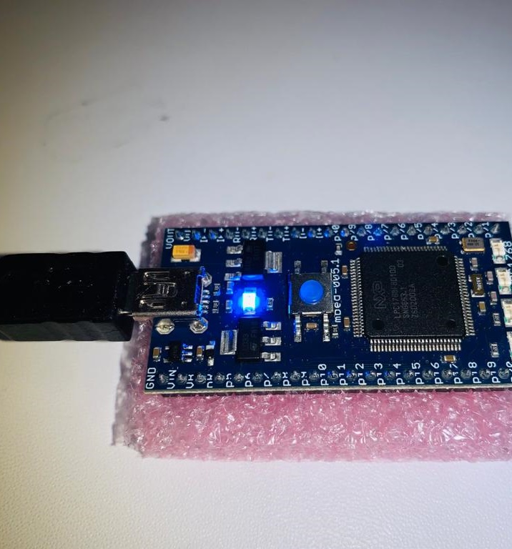
Getting started with LPC1768
Connect mbed LPC1768 to a PC – After connecting LPC1768 to PC by USB cable we can see power light on the board and after few seconds, PC will recognize the mbed Microcontroller as a standard USB drive.
Click the MBED.HTM link to get logged in : Once USB drive is appeared, go to the new USB drive and click MBED.HTM to open it in a web browser. We need to create a mbed account to get access to the websites, tools, libraries and documentation.

Slide 4
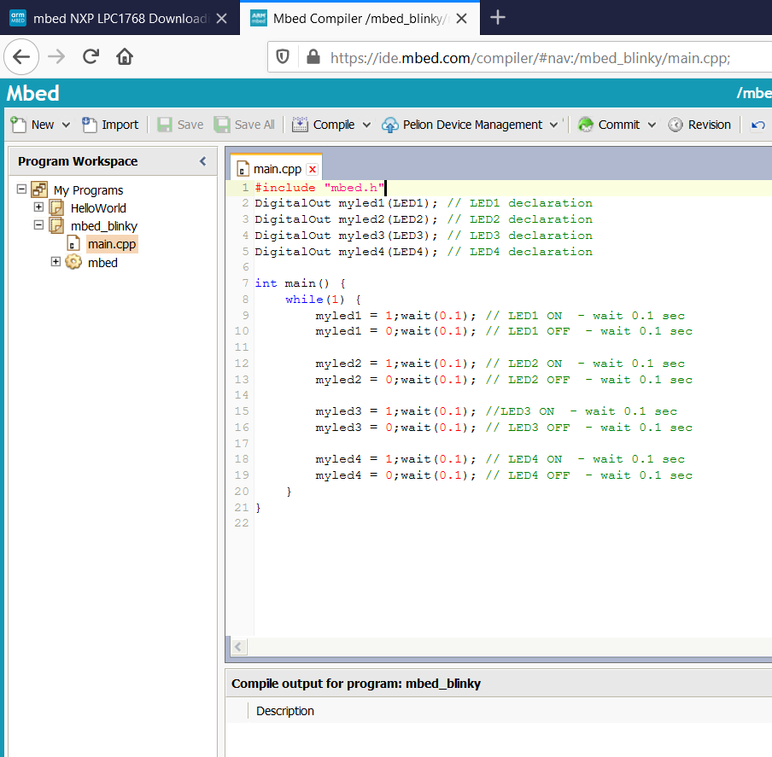
Downloading program
We can take advantage of pre-complied program to get used to downloading and running programs to check the functionality of the LPC1768.
Save and compile
Compiler output
- Error and warnings, or
- A Downloadable binary

Slide 5
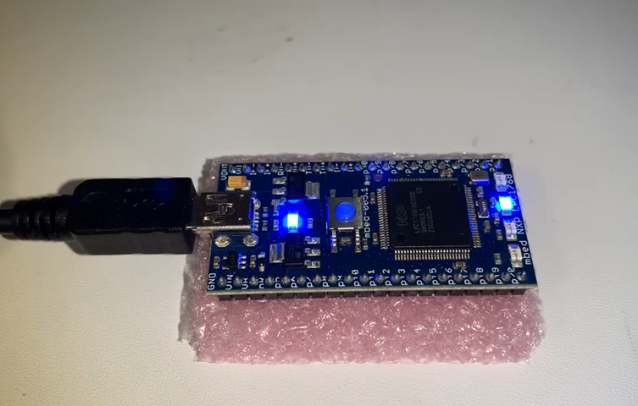
LPC1768 blinky testing
Save the binary file to USB drive
Once the file has saved to the MBED drive , it needs to be programmed into the microcontroller
Press the button on the LPC module
Code will start running.

Slide 6
LCD 1602 testing using Arduino
LCDs are ideal for displaying text/characters only. The display has an LED backlight and can display 32 ASCII characters in two rows with 16 characters on each row.
To adjust contrast and brightness we connect 10k potentiometer between 5V and GND of Arduino and center pin of the potentiometer to pin 3 on the LCD.
LCD | Arduino | LCD | Arduino
RS | 12 | D4 | 5
ENABLE | 11 | D5 | 4
RS | GND | D6 | 3
R/W | GND | D7 | 2
VSS | GND | LED+ | 5V – 220 Ohm
VCC | 5V | LED - | GND

Slide 7
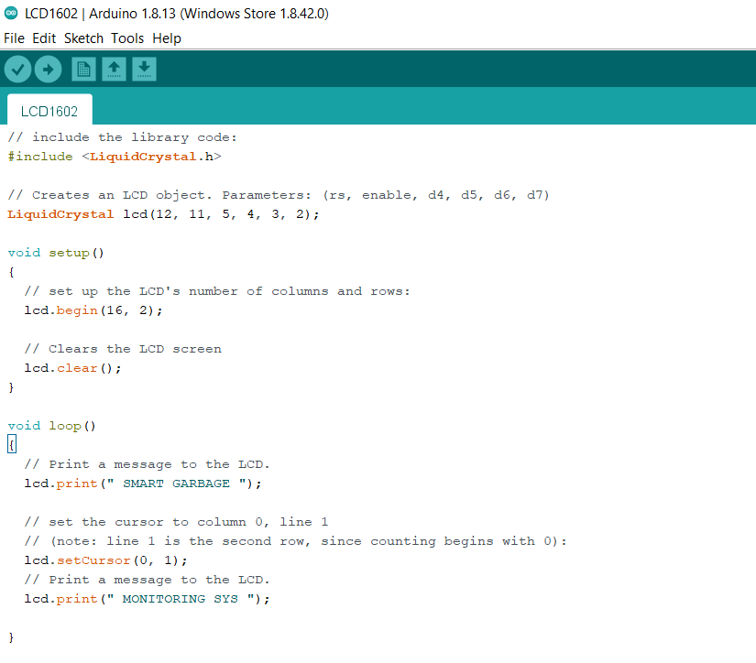
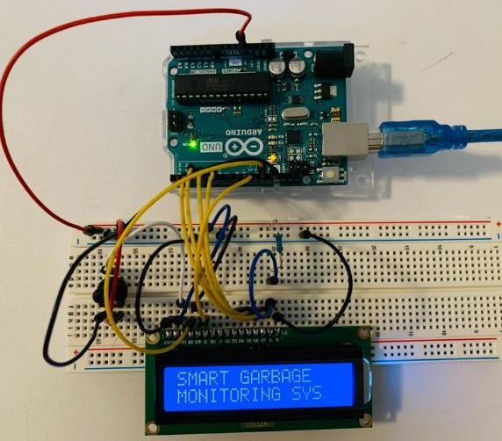
Testing code and result

Slide 8
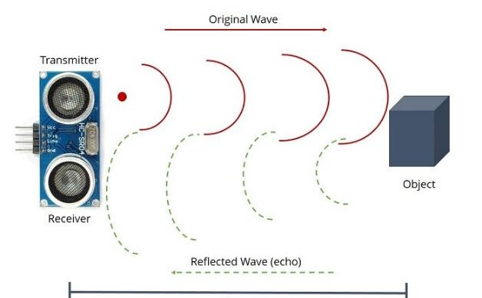
Ultrasonic Sensor (HR-SC04) testing using Arduino
Ultrasonic sensor emits an ultrasound at 40000 Hz which travels through the air and if there is an object or obstacle on its path, it will bounce back to the module. Considering the travel time and the speed of the sound you can calculate the distance.
The HC-SR04 Ultrasonic Module has 4 pins, Ground, VCC, Trig and Echo. The Ground and the VCC pins of the module needs to be connected to the Ground and the 5 volts pins on the Arduino Board respectively and the trig and echo pins to Digital I/O pin on the Arduino Board.

Slide 9
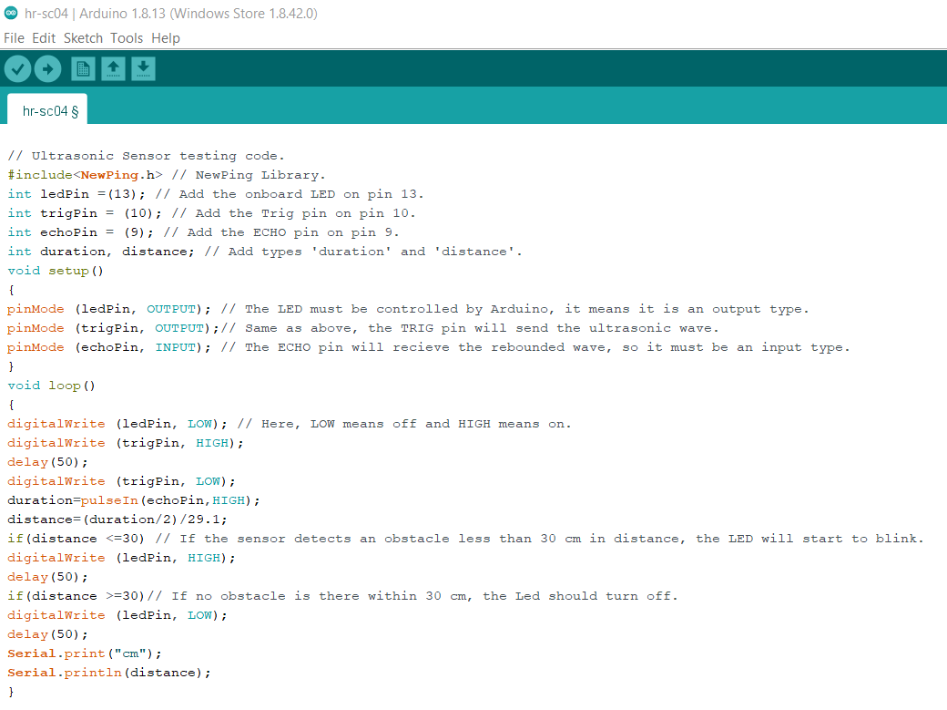
Testing code :
We can set the distance as per our requirement between (2cm- 400cm)
As sensor detects any object in specified range, an LED on Arduino board is start blinking otherwise, an LED remains off.

Slide 10
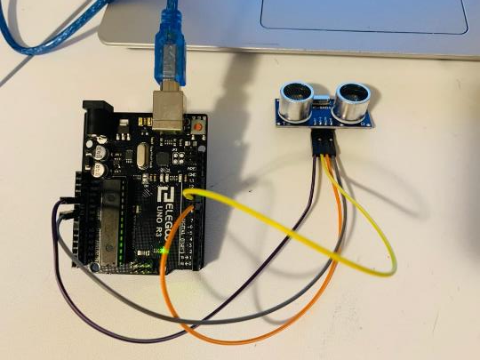
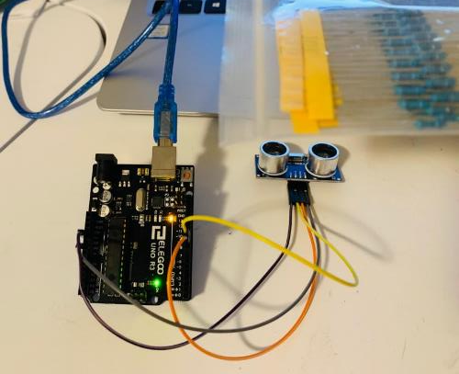
Results :

Slide 11
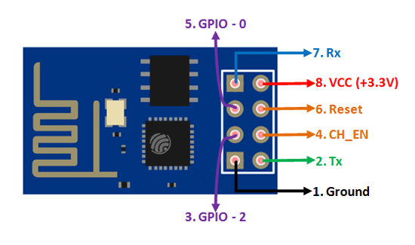
ESP8266 Wi-Fi module testing using Arduino with ThingSpeak
ESP8266 Wi-Fi module is low cost standalone wireless transceiver that can be used for end-point IoT developments.
ESP8266 Wi-Fi module enables internet connectivity to embedded applications. It uses TCP/UDP communication protocol to connect with server/client.
To communicate with the ESP8266 wifi module, microcontroller needs to use set of AT commands. Microcontroller communicates with ESP8266-01 Wi-Fi module using UART having specified Baud rate.

Slide 12
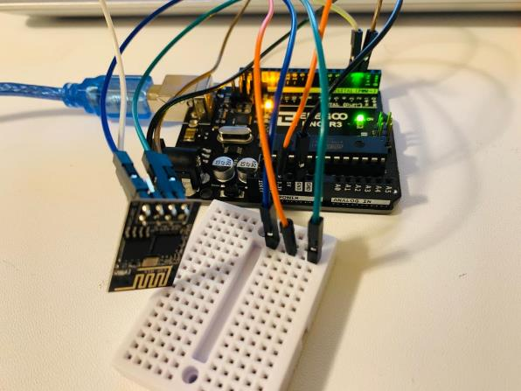
Schematic connection:
ESP8266 | Arduino
RX | RX
TX | TX
GND | GND
VCC | 3.3 V
EN | 3.3 V
GPIO 0 | NONE
GPIO 2 | NONE

Slide 13

Setting up ThingSpeak :
Thingspeak is an open IOT platform where anyone can visualize and analyze live data from their sensor devices. Also, we can perform data analysis on data posted by remote devices.
Create an account on ThingSpeak
Create a new channel with one field label
Get the API key

Slide 14
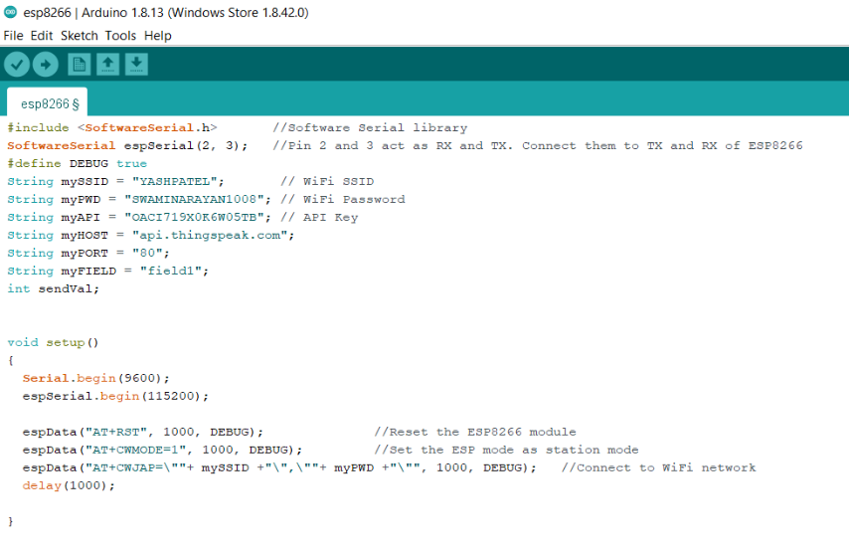
Testing code

Slide 15
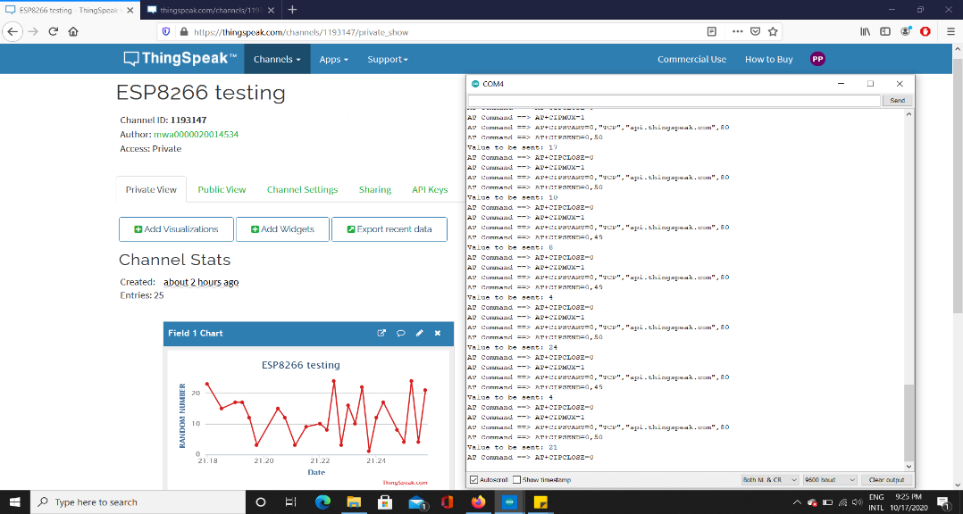
Results

Slide 16

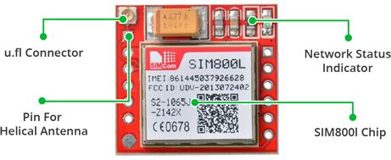
Testing of SIM800L GSM module :
SIM800L GSM/GPRS module is a miniature GSM modem, which can be integrated into a great number of IoT projects. We can use this module to accomplish almost anything a normal cell phone can; SMS text messages, Make or receive phone calls, connecting to internet through GPRS, TCP/IP, and more..
The module needs an external antenna to connect to a network. The module usually comes with a Helical Antenna and solders directly to NET pin on PCB. The board also has a U.FL connector facility in case you want to keep the antenna away from the board.

Slide 17
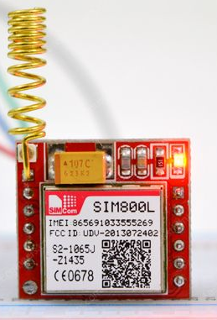
Supports Quad-band : GSM850, EGSM900, DCS1800 and PCS1900
Connect onto any global GSM network with any 2G SIM
Make and receive voice calls using an external 8Ω speaker & electret microphone
Send and receive SMS messages
Send and receive GPRS data
Scan and receive FM radio broadcasts
Serial-based AT Command Set
FL connectors for cell antennae
Accepts Micro SIM Card

Slide 18

LED indication :
There is an LED on the top right side of the SIM800L Cellular Module which indicates the status of your cellular network. It’ll blink at various rates to show what state it’s in.
Blink every 1 sec : The module is running but hasn’t made connection to the cellular network yet.
Blink every 2 sec : The GPRS data connection you requested is active.
Blink every 3 sec : The module has made contact with the cellular network & can send/receive voice and SMS.

Slide 19

Power supply recommendation :
SIM800L module doesn’t come with onboard voltage regulator, so an external power supply adjusted to voltage between 3.4V to 4.4V (Ideal 4.1V) is required. The power supply should also be able to source 2A of surge current, otherwise the module will keep shutting down.
Li-Po batteries with voltage generally in the range of 3.7V – 4.2V, perfect for SIM800L Module.
Warning : we need to be very careful about not to disconnect the GND before the VCC and always connect GND before VCC. Otherwise the module can use the low voltage serial pins as ground and can get destroyed instantly.

Slide 20
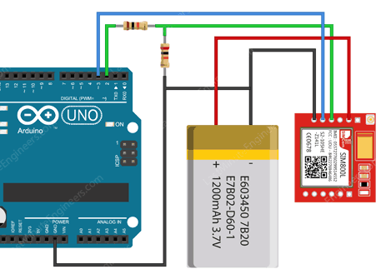
SIM800L GSM Module connection
VCC of GSM module is connected to +Ve terminal of Li-Po battery.
Tx pin is connected to the Pin3 on Arduino.
Rx pin is connected to the pin2 on the Arduino through voltage divider circuit.
GND is connected to the GND on the Arduino.

Slide 21
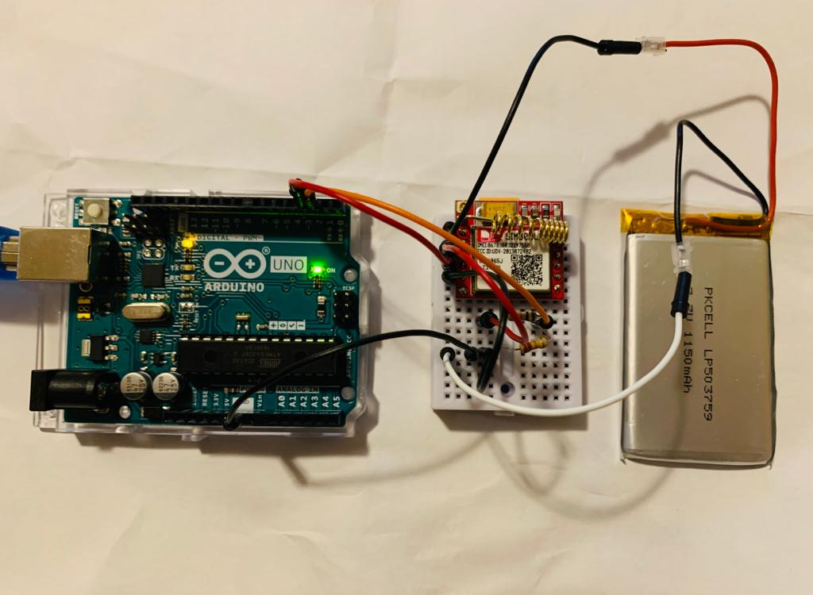
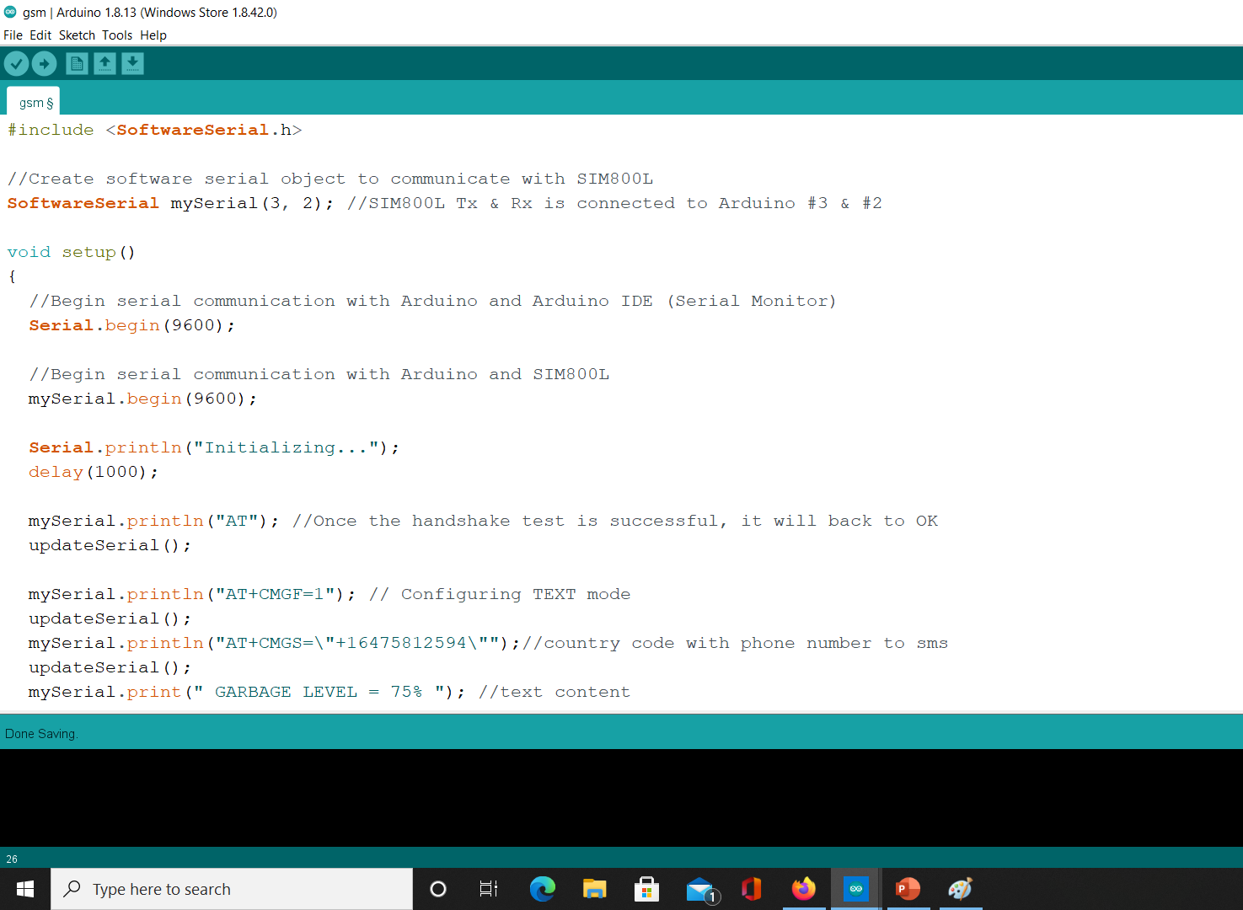
Testing code :

Slide 22
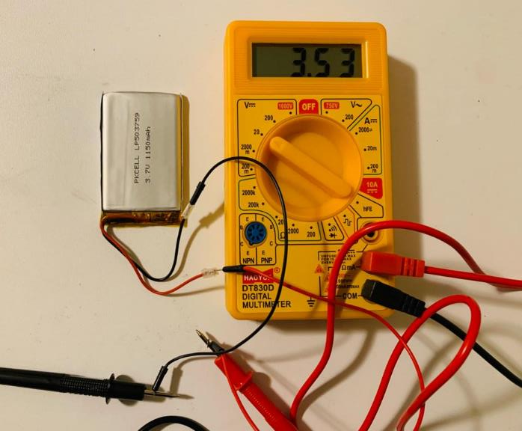
Lithium ion battery testing using DMM
Lithium ion batteries are thin, light and powerful. The output ranges from 4.2V when completely charged to 3.0V when completely dead
Measured voltage : 3.53 V

Slide 23
References :
Administrator, Says, Z., Zhong, Says, K., Karl, Says, P., . . . Zach. (2018, April 17). Connect ESP8266 to ThingSpeak: Using AT Commands & Arduino. Retrieved October 19, 2020, from https://www.electronicshub.org/connect-esp8266-to-thingspeak/
Team, T. (n.d.). "Hello World!" Retrieved October 19, 2020, from https://www.arduino.cc/en/Tutorial/LibraryExamples/HelloWorld
Mbed NXP LPC1768 Getting Started - Handbook. (n.d.). Retrieved October 19, 2020, from https://os.mbed.com/handbook/mbed-NXP-LPC1768-Getting-Started
Mbed NXP LPC1768 Getting Started - Handbook. (n.d.). Retrieved October 19, 2020, from https://os.mbed.com/handbook/mbed-NXP-LPC1768-Getting-Started
AnirudhT1, & Instructables. (2017, September 30). Ultrasonic Sensor Testing With Arduino. Retrieved October 19, 2020, from https://www.instructables.com/Ultrasonic-Sensor-Testing-With-Arduino/
https://lastminuteengineers.com/sim800l-gsm-module-arduino-tutorial/

